Slide 1
Moderate Content and Detect Harm with Content Safety Studio
<Presenter Name>
<Presenter Title>

Slide 2

Azure AI Content Safety
Generally Available
Detect and assign severity scores to harmful content
Available as a Service (API) and integrated across Azure AI
Works on human/AI generated content
Notes:
We recently released a new state of the art safety system called Azure AI Content Safety to provide an independent layer of protection.
One of the amazing things about generative AI is that this it has enabled us to build a much more powerful safety system because we've been able to leverage GPT 4 in the development of this to help us train the system and give it more examples of different types of harmful content.
Azure AI Content Safety detects harmful user-generated and AI-generated content using text and image APIs.
Customers can deploy Azure AI Content Safety as a content filtering service as part of their application to assist in complying with regulations and maintain their intended environment for end users.
We’ve also integrated this service directly into Azure OpenAI Service and Azure Machine Learning, to help developers build safer AI applications from the start.

Slide 3
Mitigation layers
User Experience
Application
Metaprompt & Grounding
Platform
Safety System
Model
Notes:
Mitigating potential harms presented by these new models requires an iterative, layered approach that includes experimentation and measurement.
We find that most production applications require a mitigation plan with four layers of technical mitigations: (1) the model, (2) safety system, (3) metaprompt and grounding, and (4) user experience layers.
[CLICK]
The model and safety system layers are typically platform layers, where built-in mitigations would be common across many applications. They are built into Azure.
The next two layers largely depend on the application’s purpose and design, meaning the implementation of mitigations can vary a lot from one application to the next.
So again, while the foundation model you’re using is obviously an important component of the system, it's not the complete system.

Slide 4
Mitigation layers
User Experience
Metaprompt & Grounding
Safety System
Model
Notes:
At the model layer, it's important to understand the model you'll be using.
One of the things that we've seen recently is a lot of innovation to figure out where and how can we bake safety directly into a foundation model.
For example, working with OpenAI, we've explored techniques like Reinforcement learning from human feedback (RLHF) and fine-tuning in the base models to build safety into the model itself, and so starting with ChatGPT and GPT 4, you see safety built into the model to mitigate unwanted behaviors.
And of course, many other models available on Azure are providing this. For example, Meta’s Llama 2 models are fine-tuned models that have mitigations built in for you, so that the model already knows how to look at certain types of sensitive queries and respond appropriately.

Slide 5
Mitigation layers (2)
User Experience
Metaprompt & Grounding
Mitigation layers
Safety System
Model
Notes:
Choosing a great base model is just the first step. For most applications, it’s not enough to rely on the safety mitigations built into the model itself.
Even with fine-tuning, LLMs can make mistakes and are susceptible to attacks like jailbreaks.
So, just like security, at Microsoft we use a layered defense in depth approach. And we apply an AI-based safety system that goes around the model and monitors the inputs and outputs to help prevent attacks from being successful and catches places where the models makes a mistake.

Slide 6
User Experience
Metaprompt & Grounding
Mitigation layers
Safety System
Model
Notes:
Let’s transition from the platform layers to what the application developer needs to do. The heart of any application are the instructions that you give to the model – the metaprompt or the system prompt, and the grounding data provided.

Slide 7
User Experience
Metaprompt & Grounding
Mitigation layers
Safety System
Model
Notes:
And finally, the last mitigation layer is user experience. How you design the actual application and position it to customers is incredibly important.

Slide 8
Deploy foundation models with a built-in safety system using Azure AI
Customer Application
Prompt
Azure OpenAI Service Endpoint
Filtered Response
Completion
Filtered Response
Synchronous Content Filtering
Abuse Concern?
Azure AI Content Safety
Asynchronous Abuse Monitoring
Harm content categories
Jailbreak risk detection
Protected material detection
Notes:
For today’s workshop, we’ll be focusing on the Safety System layer. Let’s look at how this built-in safety system works in Azure OpenAI Service.
It runs both the prompt and completion for your Azure OpenAI Service model through an ensemble of classification models built to detect problematic content like hate, sexual, violence and self-harm.
In real-time, these models can be used to help improve the quality of outputs and give customers control over the type and tone of content in their application. They can also be used to identify potential instances of abuse and alert customers of those concerns and automatically filter them out.

Slide 9
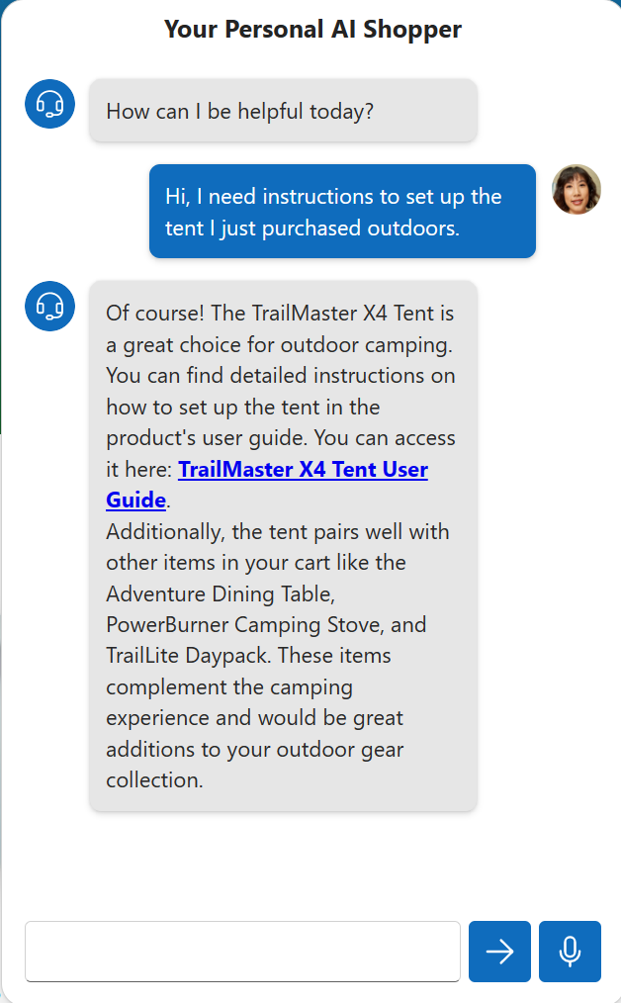
Today's case: AI-powered Website Features
Some potential harms in this scenario:
Harmful text and images
Ungrounded answers
Jailbreak/prompt injection attacks
Copyrighted material
Notes:
For our workshop, you’ll be a developer for Contoso Camping Store. Contoso Camping Store is developing new AI-powered features for their website to enhance user interaction and safety. As a developer, you’re tasked with integrating Azure AI Content Safety features into the store's platform. Your goal is to ensure that all customer support conversations in addition to user-generated content such as product reviews and images adhere to the company's content guidelines, promoting a safe and inclusive environment for all users.

Slide 10
Workshop

